Slide 1
Libraries Strengthening Connections
Digital Opportunity Project
NCLA Paraprofessional Conference 2025
Notes:
[LORI]
SAY: Thank you all for inviting us here today to provide information about the Library Strengthening Connections digital inclusion project sponsored by the State Library of North Carolina.
I’m Lori Special, Digital Skills Coordinator. Taylor Fountain, is one of the Digital Facilitators working with me and 4 others to guide and coach participants as they become competent and confident in their digital and tech skills.
You each have copies of all presentation slides in your packet and space to take notes. There is a 30-minute break for lunch that we will take at 12:15. We will have breaks during the morning and the afternoon sessions. If you need a bio-break, please feel free to take care of you needs. We plan to have you out of here no later than 4:30 pm—if you all play along.

Slide 2
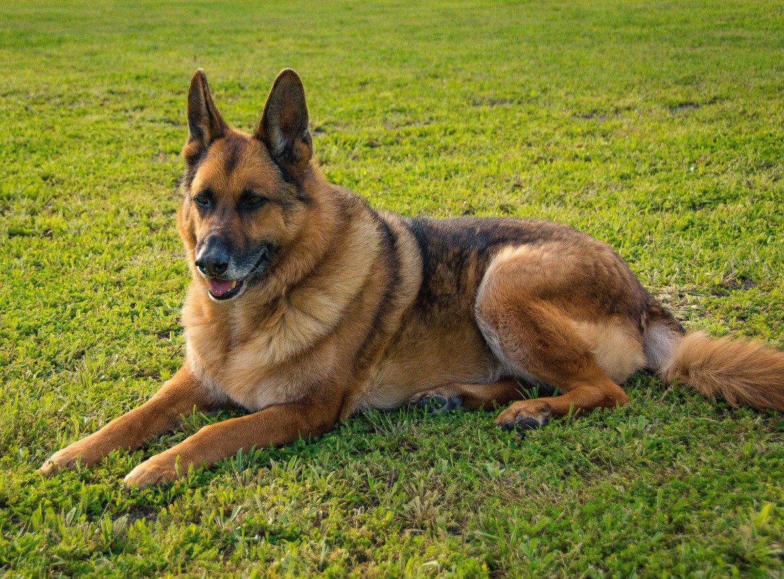

State Library Presenters
Taylor Fountain
Digital Facilitator
Lori Special
Project Coordinator

Slide 3
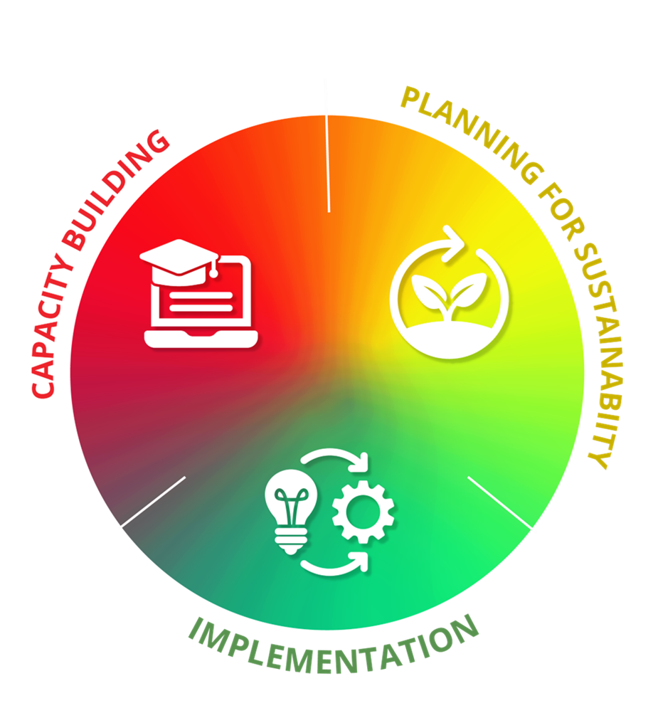
Agenda
    Libraries Strengthening Connections (LSC) project & Digital Divide
    Stages of the project & activities
    Northstar Online Learning platform

Slide 4

Why rural library staff is the focus of the LSC project?

Slide 5
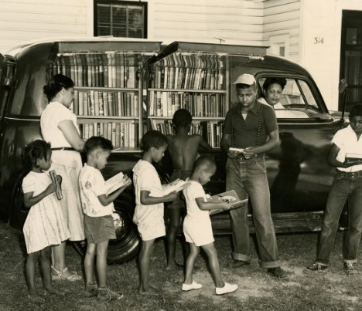
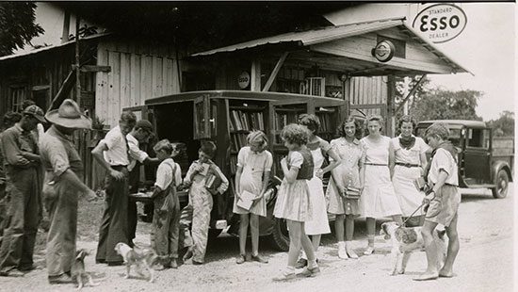
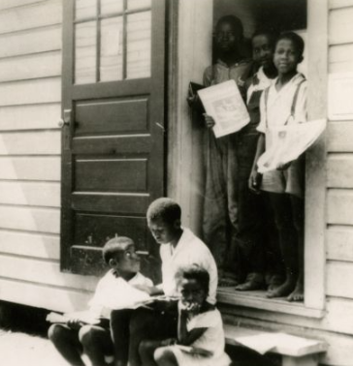
Rural library staff is the focus because…
Rural libraries are anchor institutions in communities
Library staff want and need to provide excellent service
To the public, everyone who works in a library is a librarian.

Slide 6
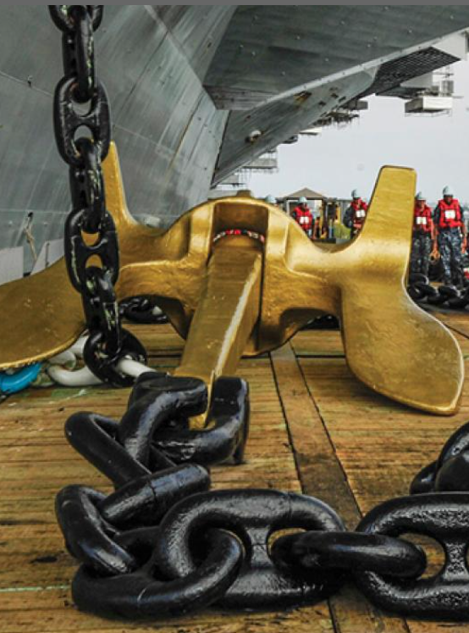
Digital Anchors help close the Digital Divide
The rural public library anchors the people of their community to digital environments.
Library staff do the work of creating connections between information, learning, and digital environments.
ar.inspiredpencil.com
Notes:
SAY: The American Jobs Plan provided %65 billion over 8 years to close the gaps in the digital infrastructure. Infrastructure does not necessarily translate to people having the internet and devices or knowing how to use it. Local and national anchor institutions—schools, public libraries, and healthcare organizations can all play significant roles in closing the divide and doing the work of digital inclusion.

Slide 7
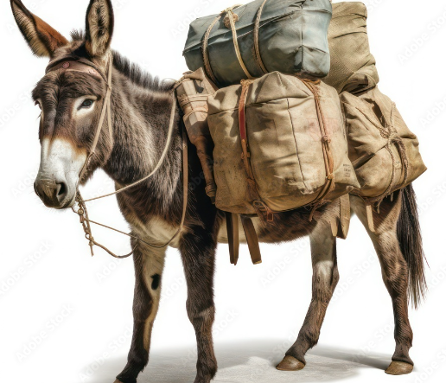
Tech/digital pack mule
“The person(s) that everyone in the library calls on when a tech thing needs fixing or a user needs tech/digital specific help.”
adobe.stock.
Notes:
[LORI]
Tech/digital pack mule.
ASK: Tell me what you think a tech/digital pack mule is or does?
SAY: a tech/digital pack mule is defined as the person that everyone else on staff calls on when a tech thing needs fixing or a user/patron needs tech/digital specific help.
The technically proficient staff who are the tech/digital pack mules often becomes tired, angry, and resentful.
ASK: Why do you think the have these feelings?
Who is your library or your branches digital pack mule?
Who answers patrons/staff questions when [insert] name is not around?
What will change once each staff person can answer basic digital/tech questions: for staff and for patrons?
SAY: The work of digital inclusion in this project , will enable you to have the skills and knowledge to help with many basic digital/tech needs for yourself and those you serve.

Slide 8

OUTCOMES
GOAL: Rural public library staff are able to provide point-of-service support to meet the digital needs of their community members and work in a rapidly evolving digital landscape.
STAFF
Identify, navigate, and successfully interact with digital technology.
Be confident in their ability to navigate and interact with digital technology and focus populations.
Transfer knowledge and skills learned during training to real problems.
Staff will identify digital navigation and support resources in the community and refer individuals to those resources.
5. Recognize the value of their work toward meeting the digital needs of the individuals, especially those who have felt excluded from library services.
COMMUNITY
Identify, navigate, and successfully interact with digital technology.
Be confident in their ability to navigate and interact with digital technology.
Access available library digital resources.
Be confident in their invitation and welcome in public library spaces.
Notes:
[

Slide 9
Stage 1
Capacity Building
Stage 2
Sustainability Planning
Stage 3
Implementation
Use Northstar to measure knowledge and enhance skills.
Schedule staff learning time
Practice your knowledge by assisting patrons with tech questions.
Model the benefits of technology proficiency to patrons (With not for…)
Provide accommodations to support digital accessibility and learning for those who need physical or educational support
Institute digital professional development for current and new staff.
Identify staff for enhanced digital training and digital leadership at each branch
Use and add to NCDIT local digital resource
Create and/or maintain a technology inventory
Create in-library and outreach digital skills programming or training
Activate your plans
Evaluate the effectiveness of your work
Make changes as needed
LSC Project Stages_NWRL_2025.docx
Notes:
Introduction to the project and Northstar & assessments
Support from the project manager and Digital Facilitator
Check-in with Digital Facilitator regularly
Practice knowledge and skills to answer library user questions
Support colleague learning and confidence
Feedback: What working what's not. You will be asked and we want honest answers. Don't be afraid to hurt our feelings. Without your input, the project cannot get better and you can't get what you need.

Slide 10
Navigating Northstar Online Learning
Log in using the username and password you have been provided by the digital facilitator.
Answer question as to where you are.
Click “Take Assessments” in menu or click on the individual button for the desired group of lesson to be taken.
Take assessments prior to engaging in the practice sessions.
To earn an official certificate, your assessment must be proctored.
Notes:
[TAYLOR]
DO: Go to NSOL page and go through the elements of the dashboard with learners.
How to log on
Explain the dashboard
Explain how to take assessments

Slide 11
Northstar
Northstar Digital Literacy
Ask your library director or manager for the Northstar link for your library.
Notes:
Take out the Proctoring NSOL handout.

Slide 12
Northstar Assessment Taking Tips
Watch the orientation video at the beginning of each assessment.
Listen and read the questions carefully.
Take your time. Assessment is not timed.
Use a mouse—not a trackpad.
You can change answers before submitting.
Take assessments as many times as needed—the goal is learning!

