Slide 1
Generative AI on Campus:
Understanding Faculty & Student Perspectives to Shape Library Support
Angela Whitehurst, Amy Cooley & Brandon Stilley
Academic Library Services
East Carolina University

Slide 2




Faculty Survey
Determine level of student generative AI literacy skills
Perception by faculty
If/how faculty integrating generative AI in classes
Interest in library collaboration

Slide 3
AI Literacy Defined
“An individual’s ability to clearly explain how AI technologies work and impact society” (Ng, Leung, et al.)
Simple Terms
  Understand
  Use
  Evaluate
Ng, D. T. K., Leung, J. K. L., Chu, K. W. S., & Qiao, M. S. (2021a). AI literacy: Definition, teaching, evaluation and ethical issues. Proceedings of the Association for Information Science and Technology, 58(1), 504–509.
Ng, D. T. K., Leung, J. K. L., Chu, S. K. W., & Qiao, M. S. (2021b). Conceptualizing AI literacy: An exploratory review. Computers and Education.Artificial Intelligence, 2, 100041. https://10.1016/j.caeai.2021.100041

Slide 4




Characteristics of AI Literacy
Familiarity with methods generative AI uses to create information
Understand the strengths & weaknesses of generative AI
Demonstrate the ability to evaluate AI generated content
Understand ethical issues related to generative AI
(bias, equity, privacy)

Slide 5
Methodology
ECU College of
Engineering & Technology
  Computer Science
  Construction Management
  Engineering
  Technology Systems
Survey
Population: 102 Faculty
Email Survey:
  Qualtrics
  21 completed
  20.5% response rate

Slide 6
Key Findings: Student AI Literacy Skills
Overall perception: students lack AI literacy skills
  Don’t know how the output is created & take at face value
  Aren’t familiar with strengths & weaknesses
  Very concerned about students evaluating output
Majority agree AI Literacy important skill for future
workforce (67%)
Some concern about AI ethical issues

Slide 7
Key Findings: Faculty Use of AI in Courses
Approximately ½ of faculty addressed AI in courses
75% not used with classes
25 % experimented with tools (mixed results)
Open ended comments
  Faculty don’t know much about generative AI
  Faculty need training
  Need guidance from university

Slide 8
Key Findings: Library Collaboration
Past collaboration
  60% No
  40% yes
Means of past collaboration
  Library Instruction
  Referred students to librarian
  Referred students to research
  guide
AI Collaboration (Preferences)
  Online Tutorial
  Library Instruction/Guest Lecture
  Research Consultation with students

Slide 9

Actions Taken
Created multiple lesson plans
Integrated into instruction
Created online tutorial
Experimented with AI tools

Slide 10


Lessons Learned: Faculty Survey
UNDERSTAND VIEWPOINTS
& NEEDS
LESSONS & LEARNING OBJECTS
PROVIDE ADVICE & GUIDANCE
GAIN KNOWLEDGE

Slide 11
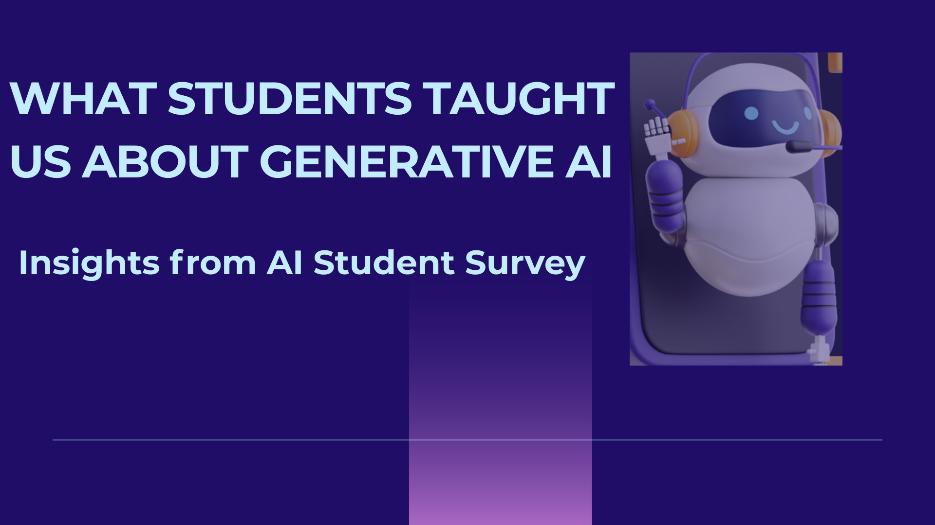

Slide 12
Methodology
ECU Students
  Qualtrics survey to gauge student AI usage & perception
  Anonymous & voluntary participation
  33 questions (mostly multiple choice with optional comments)
  Prioritized question order by most beneficial responses
  Adapted from SDSU’s AI Student Survey Instrument
  Approved by IRB, Greenphire, and IPAR
*option to opt-in to be considered for a prize at the end of the survey

Slide 13
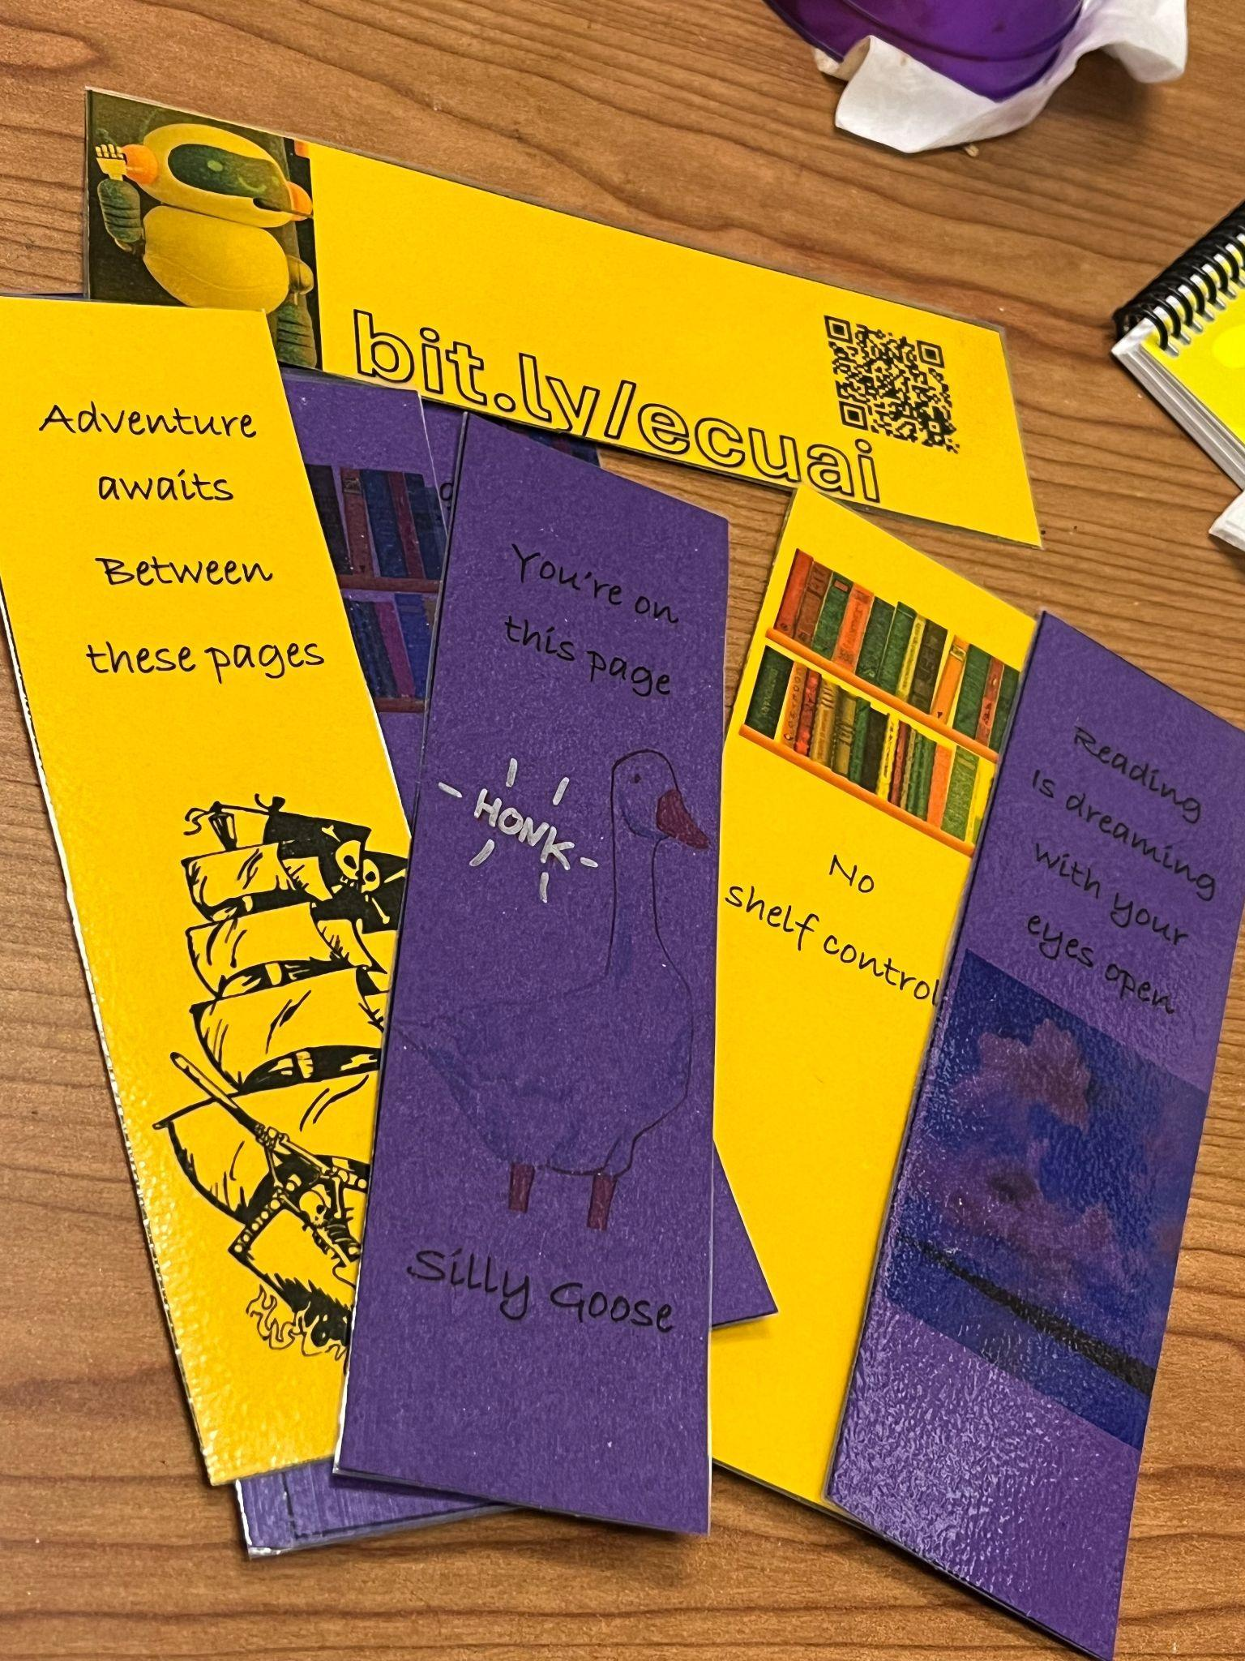
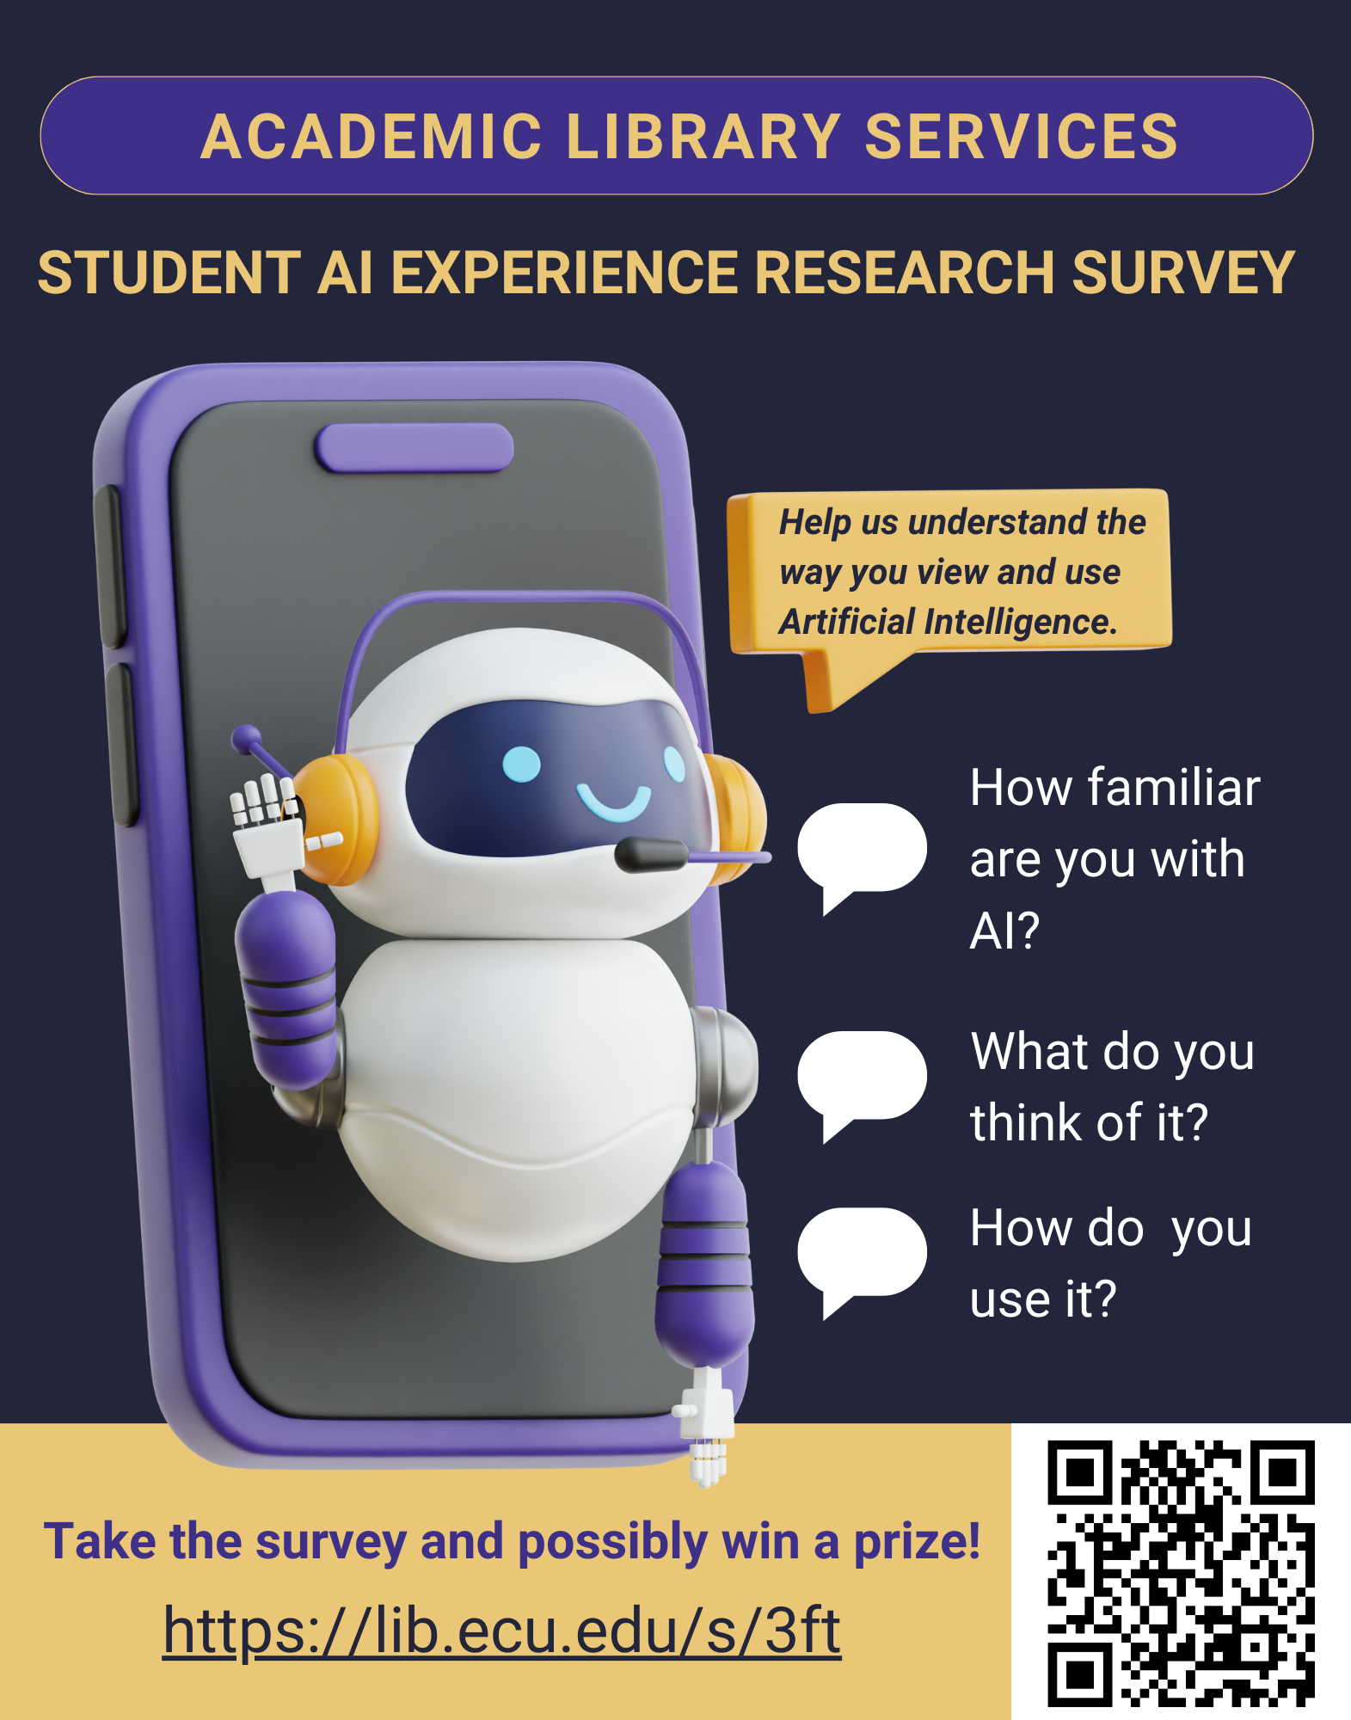
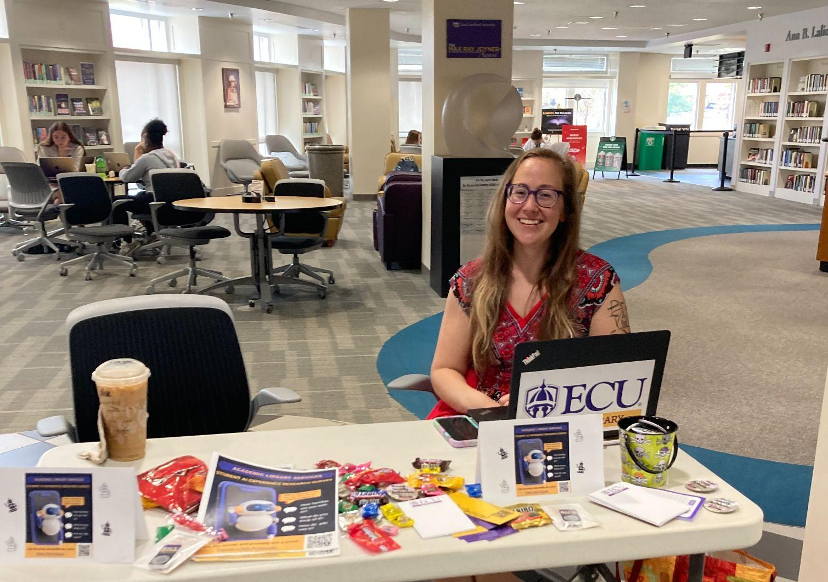
Getting the word out!

Slide 14
Response Rate
Survey active: 9/18-11/26 2024
~10 weeks (including fall break & thanksgiving break)
267 Responses
Anonymous link: 66 QR Code: 197 Preview: 4
*228 responses beyond initial consent page

Slide 15
Response Choices
Strongly Disagree
Disagree
Somewhat Disagree
Somewhat Agree
Agree
Strongly Agree

Slide 16
Key Findings:
60% regularly use AI-powered tools in their studies
68% are not comfortable submitting a prompt to an AI tool and turning in the answer it provides
57% think AI will play a significant role in their future career
60% of students feel their curriculum lacks adequate AI training
55% of students want formal AI training
48% are actively seeking opportunities to learn more
87% have concerns about AI’s long-term societal impact
47% believe AI has the potential to solve complex global problems
83% worry about AI negatively affecting human creativity

Slide 17
In Their Own Words
Prompt: I UNDERSTAND HOW TO EVALUATE THE CREDIBILITY AND ACCURACY GENERATED BY
AI TOOLS 58 % Claim that they do
39% Do Not
Somewhat agree
"I know that it gives me a general idea but I'm not sold on the accuracy as it is still a developing technology"
"I know that not everything is 100% accurate and that I should also do my research and use my best judgment"
"Sometimes it's hard to determine if the answers are correct or not. Since google has added an AI to their search, it's definitely harder to find the right answer"
"Verifying the AI response with 3 or 4 other sources is how I check the accuracy of the information"
"My use of AI is not for facts, but more to understand a concept"
"Fact Check", "Check" & "Verify" seem to be the most popular words used in the replies to this question

Slide 18
Possible Stigma Attached to AI
"Getting an AI to do the work for you is lazy at best, and academic dishonesty at worst."
"Quite frankly, if you can't be bothered to do the work yourself and come up with your answer, why study?"
"AI does the work for students instead of them actually learning themselves."
"Using AI to complete assignments is a shortcut that undermines the value of doing the work on your own."
"It’s a missed opportunity for learning if you just let AI do the thinking for you."
"Relying on AI is like letting someone else do your homework—lazy and defeats the purpose of education."

Slide 19
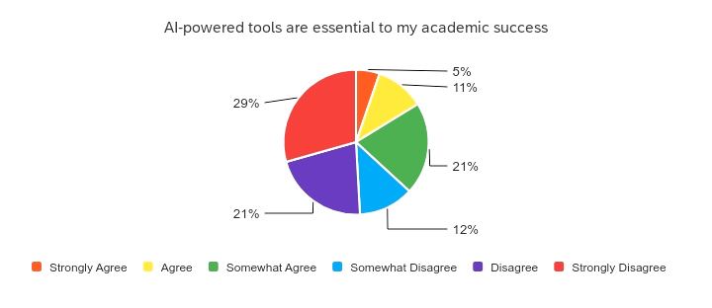
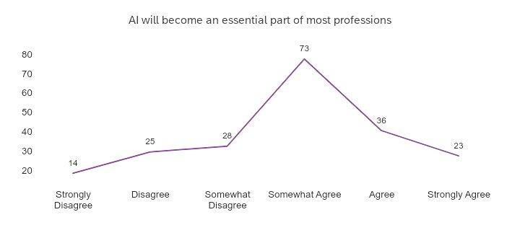
Generalizations
Students are using various AI tools
Students don’t necessarily view AI tools as crucial
A clear majority of students believe that AI will be important in their future career
A significant majority of students Agree that AI has positively affected their learning experience & Disagree that AI has negatively affected their learning experience

Slide 20
Next Steps…
We can address gaps by:
-incorporating AI into library information literacy sections to provide learning opportunities & discuss ethical usage
-creating supplemental material/workshops
-sharing our survey findings with ECU instructors
73% of student respondents are concerned about AI’s
impact on job security- to set students up for future success, we need to address AI usage within education

Slide 21
Looking at both surveys-
Everyone Desires Academic Transparency
Students are unclear on expectations when a majority of instructors don’t address or use AI tools
Faculty members unclear about what they should know/use and how to deal with academic integrity issues when not addressed by university
Both need & want clear, consistent guidelines and training

Slide 22
Looking at both surveys-
Students are using AI tools
60% of student respondents view AI as more useful than intimidating
Healthy Skepticism
Faculty are not using AI Tools as much
Perceive students have poor AI literacy skills
Concerns about critical thinking skills
Need training themselves to implement more in classroom
Both believe AI skills will be important in the future workforce

Slide 23

Our Response
Strengthening foundational and applied AI skills
Modeling Ethical Behavior
Working with AI Council
Classes & Workshops Offerings
Enhancing and Updating our Research Guides

Slide 24
Relevance to Library Employees
Important to understand campus culture
Inform decisions about future library services
Future AI applications in all library departments
  AI assisted literature reviews
  Virtual Assistants/Chatbots
  Data analysis
  Automated metadata creation
  Streamlined cataloging processes
  Digital Scholarship
Educate ourselves

Slide 25

Questions?

Slide 26

Questions for You
How is your campus responding to the rise of AI in teaching, learning, or assessment?
What role do you think the library should play in AI literacy or support?
Where do you see the biggest gap—awareness, training, ethics, policies, or something else?

Slide 27


