Slide 1
Equipment Lending:
Providing the Technology Patrons Want and
Managing Common Tech Issues
William Gee, Head of Interlibrary Loan (former Head of Circulation & ILL)
Blume Mansfield, Equipment Manager, Circulation Department
East Carolina University, Academic Library Services
Paraprofessional Conference 2025
Greenville, NC, May 16, 2025

Slide 2
Overview
About ECU & Our Library
Development of Circulation’s Equipment Collection
The Equipment We Circulate & Why We Do
Repair Form & Analysis
Tips on Resolving Tech Issues
Training Circulation Coworkers
Collaborating with IT
Trends, Logistics, & Takeaways

Slide 3

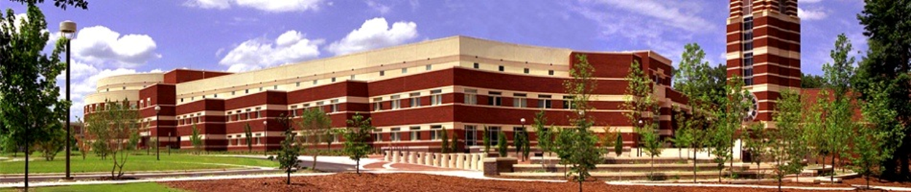
About ECU & Our Library
East Carolina University
State institution of the UNC System
Enrollment of 26,700+ students
  Many first-generation students
  Mostly in-state, 46 states, and 70 countries
R1 Classification
  85 bachelor’s, 68 master's, 13 doctoral degrees
  100 professional certificates
  Large distance education programs
  Largest programs in business & health
  Strong emphasis on service and regional transformation
Main Campus Library & Music Library
1⁺ million print volumes & 1.5 ⁺ million e-books
550 ⁺ databases/e-packages & 100,000 ⁺ e-journals
Over $4m acquisitions/e-resources budget
Numerous primary source collections
Member of ASERL, Carolina Consortium, NC LIVE
  https://facts.ecu.edu/

Slide 4
Development of Circulation’s Equipment Collection
2009-10: 1st equip policy & webpage- only laptops, video cameras, tripods, headphones & calculators
2011: 11 types- iPads, Kindles, Nooks, & cassette player
2018: 40 types- Laptop Kiosk, portable printers & scanners
2025: Withdrew down to 45 types
2022: 52 types- Swivl, lasers,& drawing tablets
2016: 16 types- GoPros, Projectors Microphones, Blu-Ray/DVD drives/players
2020: COVID added many laptops, headsets, webcams, & hotspots

Slide 5


Why provide equipment?
Financial difficulties & expense of equipment
Laptops *
Cameras
Classes only use briefly
Thermal Imaging Camera Laser Range Finder ** Portable Sound System Art Kits
Useful in emergencies and times of change.
Omni Power Bank
Hotspots
Computer Peripherals
Niche for in-library study and stress-relief
Fidget Kits
White Noise Machines

Slide 6


Why provide equipment?
Libraries are hubs for modern research with technology
Changing purposes: books and technology
Books were only 33% of our circulation in ’23-’24.
Beyond research: community & leisure are important.
Projectors, board games, sound systems, etc.
Different purposes require different equipment.
Joyner Library serves as a general equipment hub.
Laupus Library and Music Library are more specialized.
Academic integrity
Education tech integration
Hybrid learning
Libraries as hubs for modern research as technology advances
  Libraries’ changing purpose: books and technology
  Books were only 33% of our library’s circulation in ’23-’24.
Beyond research: community & leisure are important.
  Projectors, board games, sound systems, etc.
Education tech integration: hybrid & academic integrity
Different purposes require different equipment.
  Joyner Library serves as a general equipment hub.
  ECU’s Laupus Health Sciences Library and our Music Library are far more specialized.

Slide 7
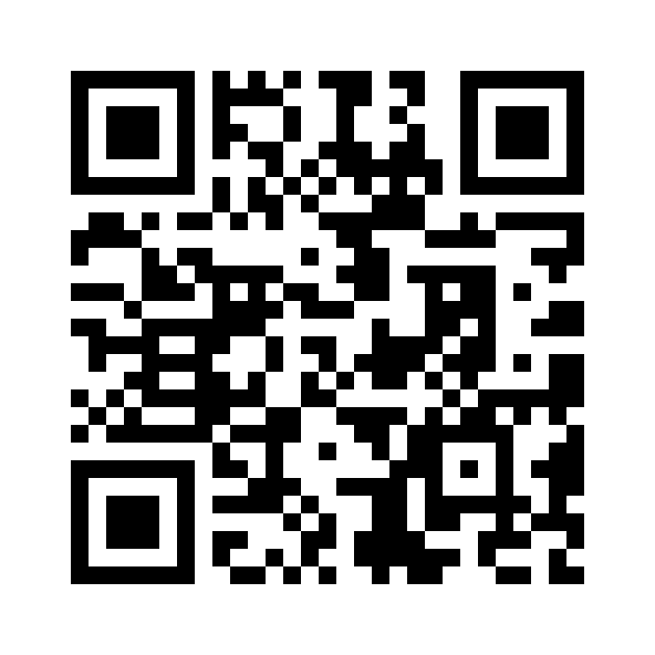
Circulating Equipment at Joyner Library, 2025
Adapters
  HDMI, Headphone and USB-C
  International Plug Adapter
Art Kits
Board Games
Cameras
  DSLRs, Mirrorless and Thermal
  Accessories and Lens Kits
  GoPros
Calculators
  Financial, Graphing, and Scientific
Chargers: Cellular and Laptop
Computer Peripherals
  Keyboards, Mice and Webcams
  Graphic Tablets
DVD & Blu-Ray Players/Drives
Fidget Kits
Film-to-Digital Converter
Hotspots
Headphones and Headsets
Laptops
Microphones
  Omnidirectional, Teaching, and Wireless Lapel
Mobile Printers and Scanners
Office Kits
Portable Whiteboards
Presentation Pointers
SD Card Readers
Sound Systems
Swivl CX Robotic Mounts
Video Projectors and Screens
Vlogging / Phone Media Kit
White Noise Machines
https://library.ecu.edu/services/borrow-equipment/
Purple denotes the most popular items.

Slide 8
Equipment Purchasing
Selection
Primarily student suggestions
Technology advancements in in all areas
Examples from other institutions
Funding
Mixture of funding sources
Repairing versus reordering - the delicate balance
Trial runs of a few to lessen a first investment
Notes:
Primarily students suggestions, given ECU's demographic.
Requests at the desk, surveys given periodically, occasional word-of-mouth at the circulation desk when returning/renting equipment.
Occasional faculty suggestions, sometimes required for specific courses.
Tech advancing further in the world.
As tech develops and moves further, so shall we.
New equipment requires new ports and attention, new programs more training.
Proven and attempted examples from other institutions, as well as documentation.
Mixture of funding sources.
Student technology fees, library's budget, and specific purchases of large items.
Fixing versus reordering, and the delicate balance of such.
Some things stay good and just need some light fixing. Others not so much.
Trial runs to lessen financial impact.
Buy a few, see if they work, then buy more if they do.

Slide 9
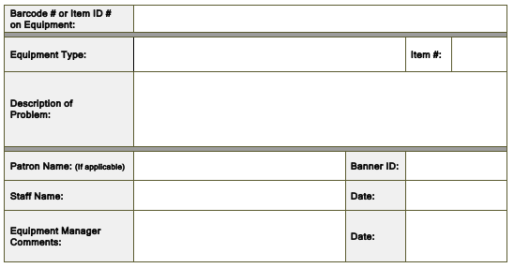
Repair Form
For damaged items and missing parts
  Completed by staff at Circulation Desk
  Given to the Equipment Manager
Form was used less often in ‘24-’25.
      Equipment Manager’s workspace is
      now nearer the Circulation Desk.
      They serve more often on the Desk, too.
Damaged and missing parts are still noted in our circulation system until suitably replaced or fixed.

Slide 10
Analysis of Equipment Repair Forms

Slide 11
Analysis of Repair Forms: Forms by Equipment Type

Slide 12
Analysis of Repair Forms:
Laptop Issues, 2021-2024

Slide 13
Analysis of Repair Forms: Other Equipment

Slide 14
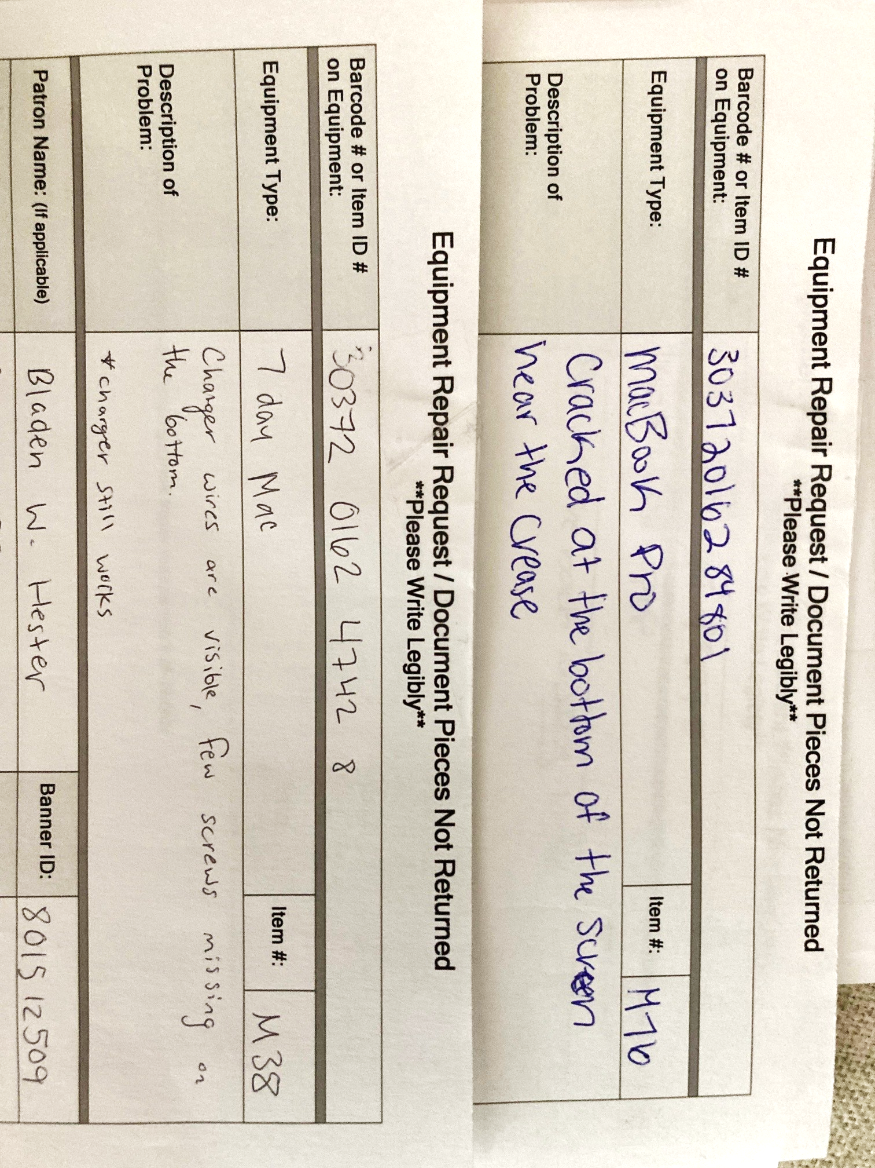
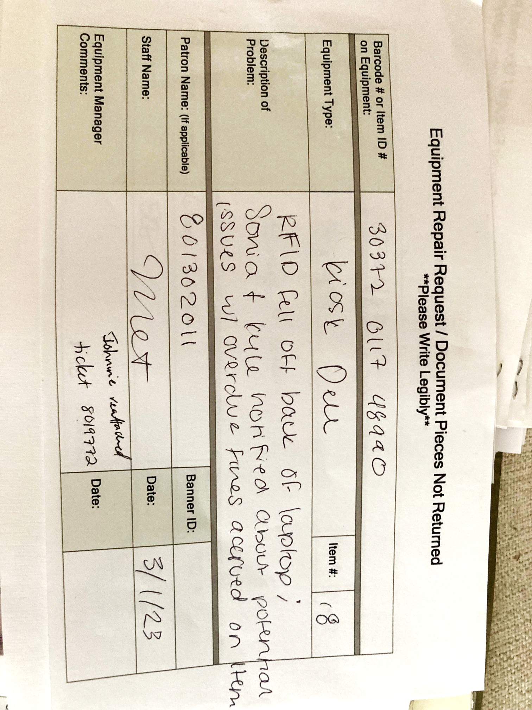
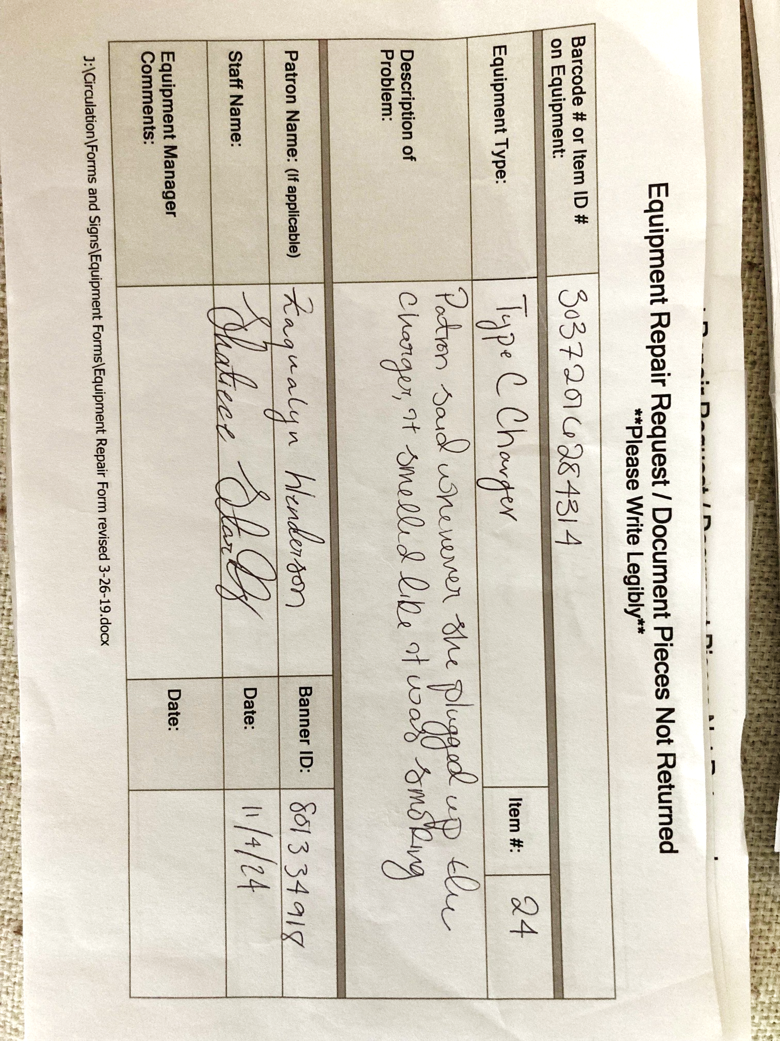
Repair Forms:
Laptops – Everything Can Go Wrong & Does

Slide 15
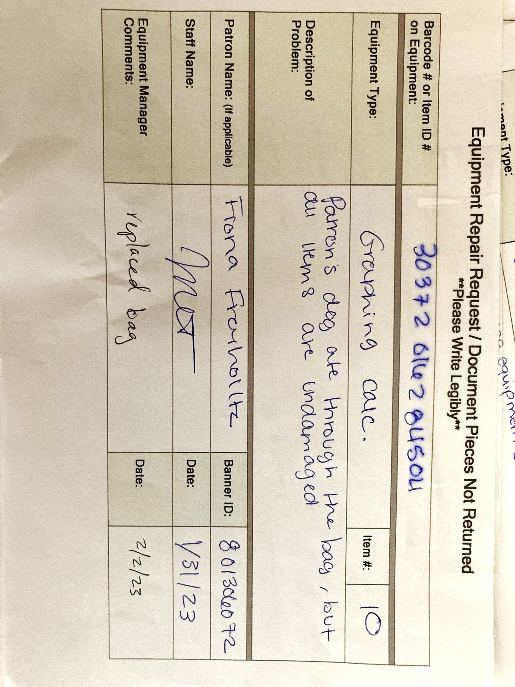
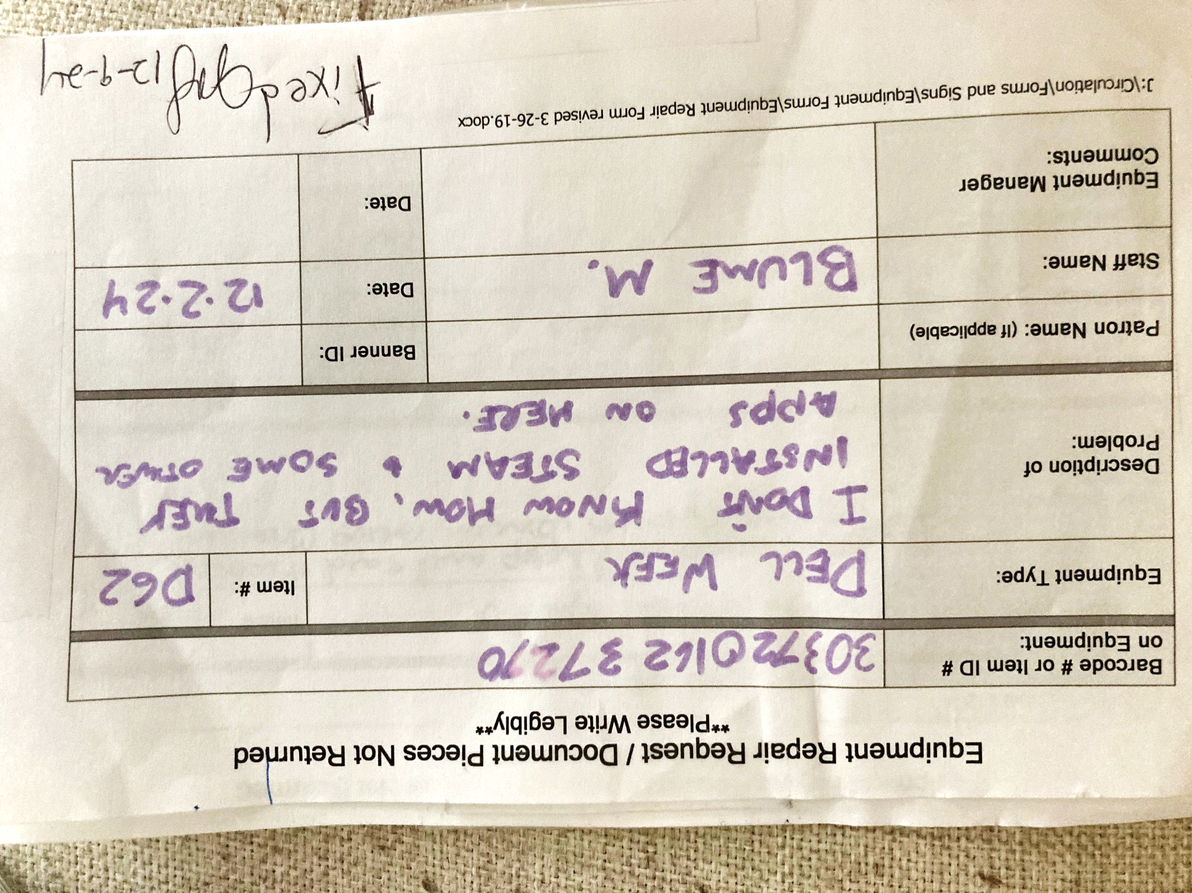
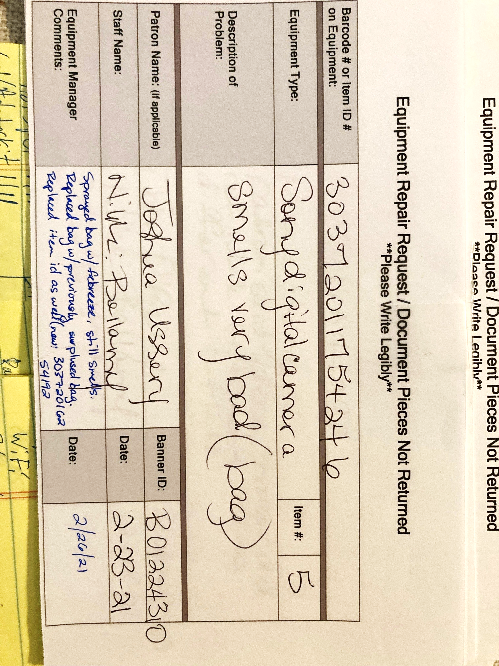
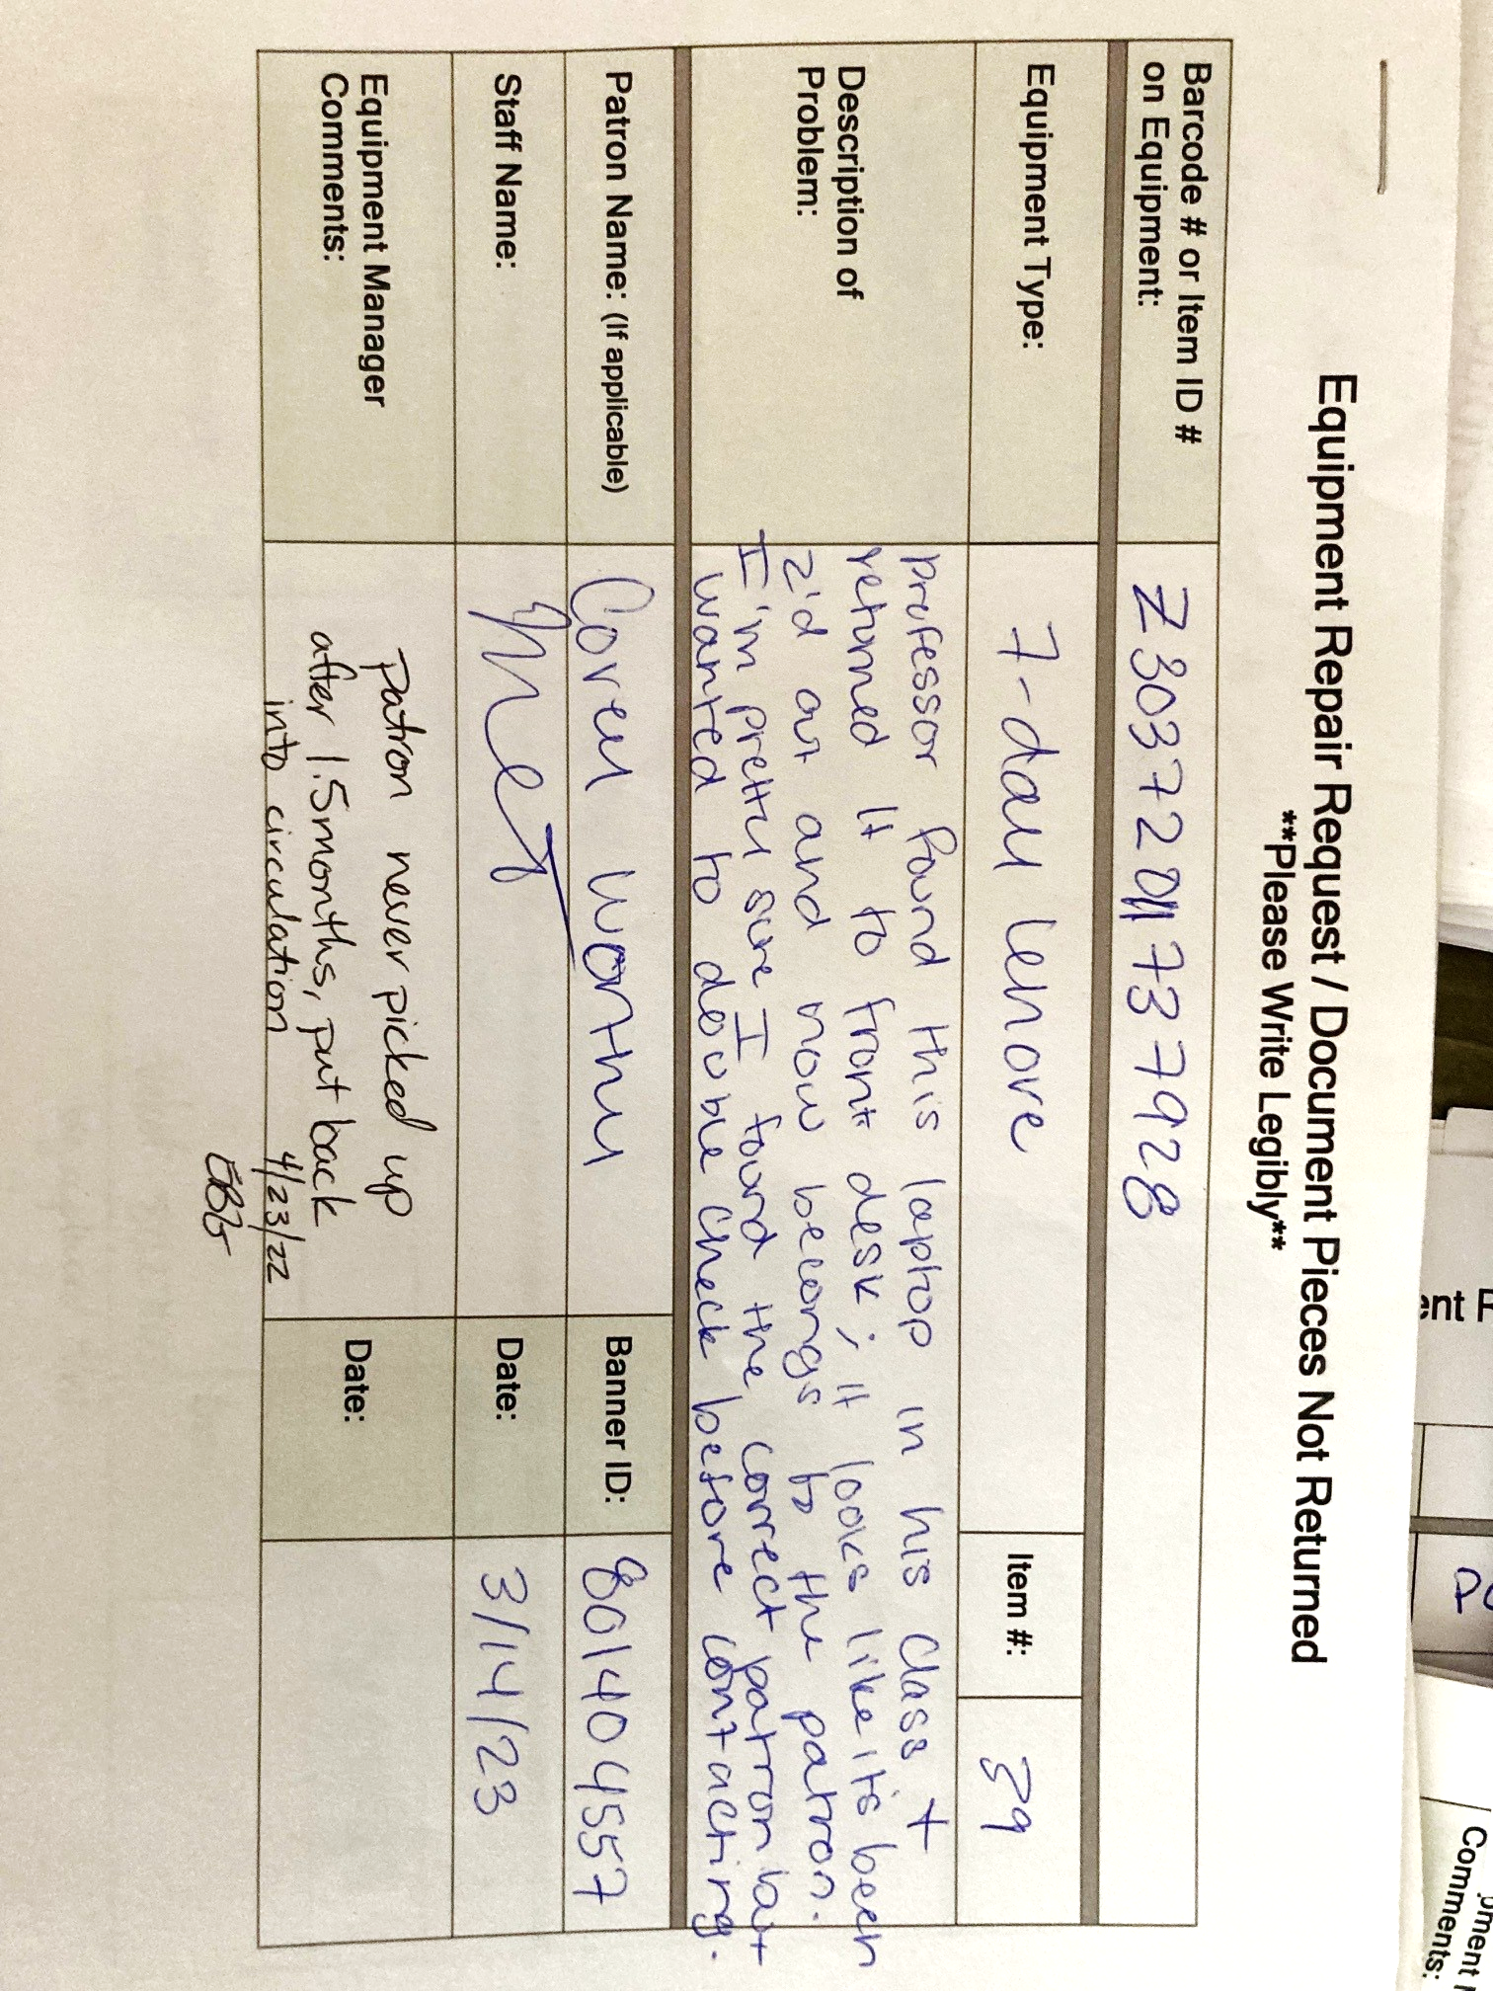
Equipment Repair Forms:
What Did the Patron Do?

Slide 16
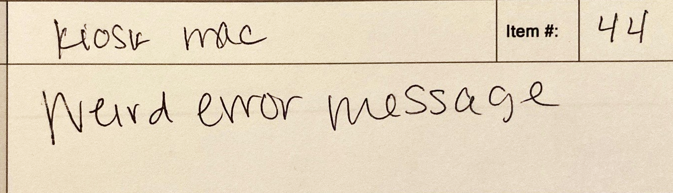
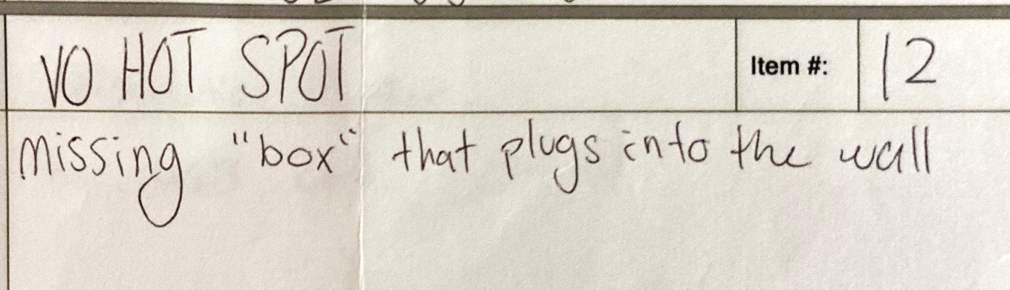
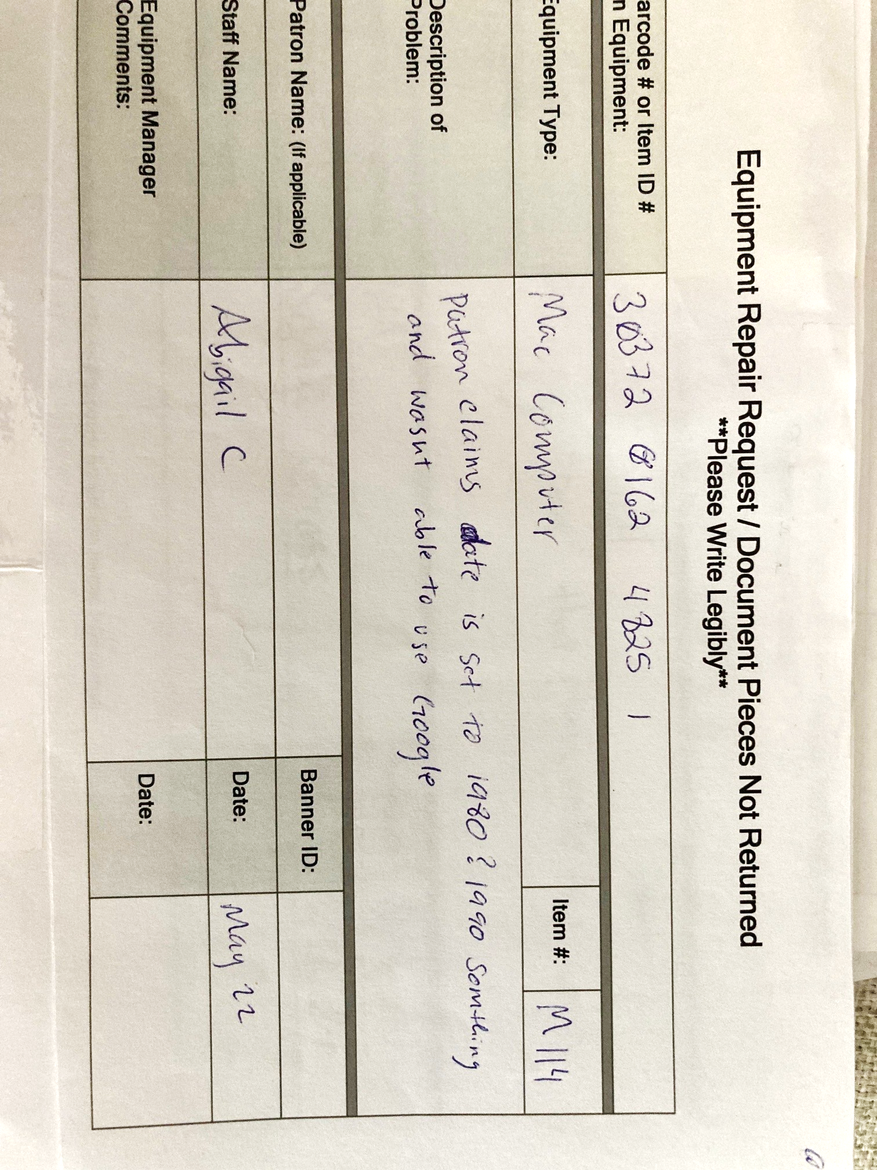
Equipment Repair Forms:
What did the Patron Say?

Slide 17
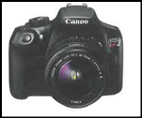
Tips on resolving tech issues & helping patrons
Always try the most obvious things first. Occam's Razor exists for a reason.
Turn it off and on again. Rebooting often fixes simple software issues.
If not turning on, it is potentially a battery issue.
    Check if the battery is missing, dead, or weak.
    Replace or recharge. Try a different charger and wall outlet.
Having patience is a must.
    Every tech issue can be unique.
    Some are a quick fix or a more irritating endeavor.
    Patience helps keep everything calm.

Slide 18
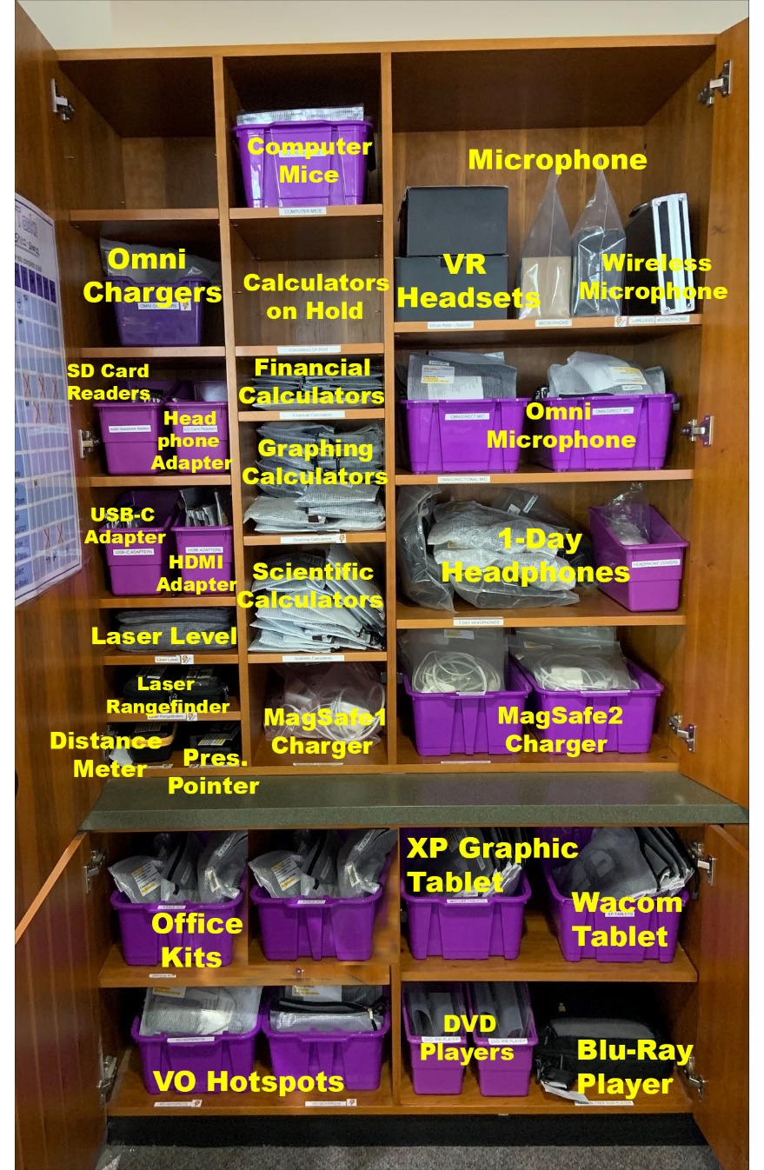
Training Circulation Coworkers on Technology
Training topics
    Identify equipment items
    Determine the type of issue
    When to pass along for help
Many issues are software problems.
Other issues are more simple day-to-day fixes
  Bag and label maintenance
  Assessing for lost and damaged parts
  Sending items to library IT if needed
  Laptop kiosk problems

Slide 19
Tips on Collaborating with IT
Meet, talk, and be friendly with them.
Understand and accommodate their workflows and process times.
Request assistance their preferred way (tickets, email, etc.).
Be clear about the issue and what you’ve tried. It saves time.
Be upfront about department/patron deadlines (e. g. need for finals).
Be capable. Fix it yourself when you can. Save IT for difficult issues.

Slide 20
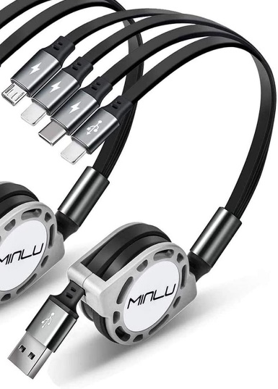
Trends
Chargers and laptops have by far the highest checkouts.
HDMI kits and USB-C adapters are increasing.
Fidget kits & white noise machines are now popular.
Some items check out mostly seasonally.
  Calculators during math test weeks
  Cameras during weeks before graduation and breaks
  Swivls during College of Education projects

Slide 21
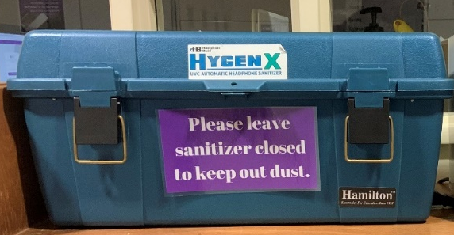
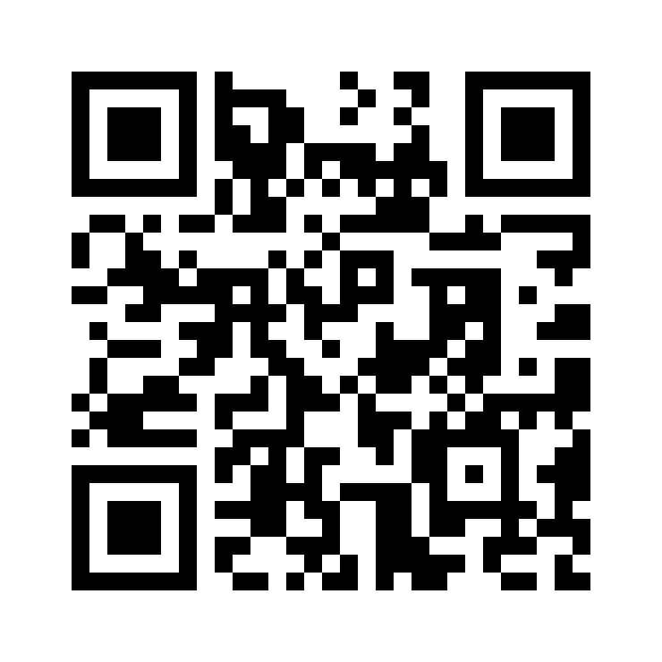
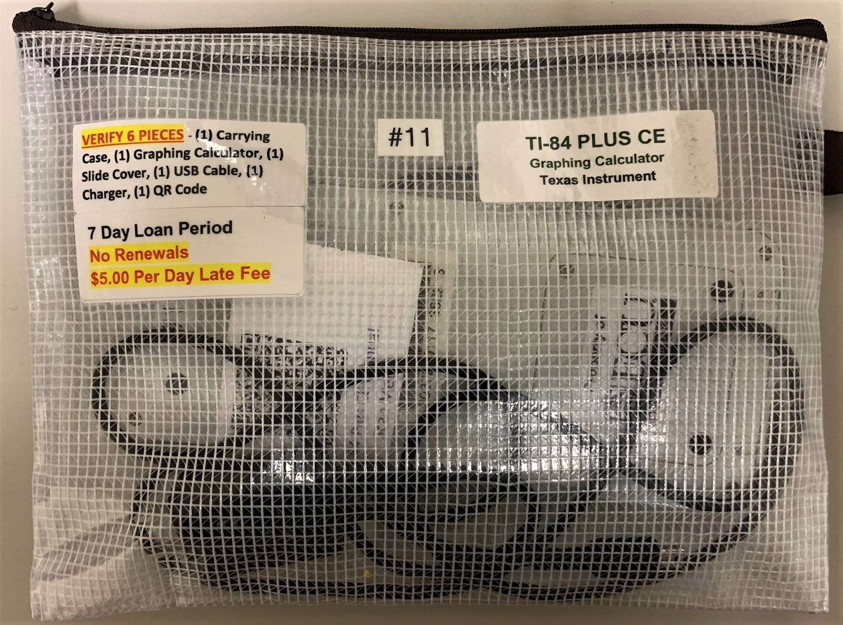
A Few Final Logistical Tips
Missing Pieces and Disputing –
Accept Or Refuse
Equipment Use
Procedure
Cleaning Equipment – Do's And Do Not's
Bags –
Quality Vs Quantity
https://library.ecu.edu/services/borrow-equipment/equipment-use-procedure/

Slide 22

Takeaways
Equipment circulation meets patrons’ needs.
Equipment is different than books in many ways.
    cost, space, parts, lifespan
    troubleshooting, repairs, replacements
Be selective, plan, train, and publicize.

Slide 23
Your Questions and Tips
If you have anything to tell us or ask us, please reach out!
William Gee’s email: geec@ecu.edu
Blume Mansfield’s email: mansfieldp22@ecu.edu
Thank you for attending our presentation!

