Slide 1


AI INTEGRATION IN LIBRARIES
LEVERAGING GENERATIVE AI FOR RESEARCH, OUTREACH, AND DIGITAL FLUENCY
Libraries are evolving into digital knowledge gateways. AI tools like ChatGPT, Gemini, and Claude enhance library services.
Today we'll explore how generative AI supports research, outreach, and digital fluency in modern libraries.
Presented by Donte’ Perry

Slide 2


ABOUT YOUR
PRESENTER
DONTE’ PERRY
Faculty, INFORMATION TECHNOLOGY | ROWAN-CABARRUS CC (RCCC)
PRESIDENT | METROLINA LIBRARY ASSOCIATION (MLA)
AI INTEGRATION EXPERTISE
Specializes in AI integration in academic settings, focusing on student success, digital fluency, and faculty development.
ACTIVE AI RESEARCH & APPLICATIONS
Research generative AI tools (ChatGPT, Perplexity, Elicit, Consensus, Gamma, and more) for teaching, advising, and academic support.
EDUCATIONAL BACKGROUND
  Current Master of Science in Information and Cybersecurity Technology (MSICT) Graduate Student
  Holds a Master of Library Science (MLS) and Master of Information Science (MIS)
  Focused on leveraging AI for practical applications in education, libraries, and digital learning

Slide 3
THE LIBRARY'S ROLE
IN THE AI ERA
ENHANCED RESEARCH SUPPORT
DIGITAL FLUENCY & AI LITERACY
AI tools empower libraries to assist students and faculty with deep research, fact-checking, and content discovery, improving academic outcomes.
Libraries play a key role in fostering digital literacy and AI competency, preparing patrons to navigate AI-generated information responsibly.
EXPANDED OUTREACH & ENGAGEMENT
OPERATIONAL EFFICIENCY & INNOVATION
AI-driven content creation helps libraries produce targeted newsletters, virtual guides, and interactive services, expanding community engagement.
Generative AI streamlines reference services, automates repetitive tasks, and supports innovative programs without increasing workloads.

Slide 4
WHAT IS
GENERATIVE AI?
COMMON TOOLS
AI that creates human-like content including text, images, and code.
Relevance to Libraries
  Efficient patron support
  Enhanced digital literacy
  Research support
  Workflow automation
CHATGPT, GEMINI, CLAUDE FOR TEXT
PERPLEXITY
FOR GENERAL APPLICATIONS
ELICIT & CONSENSUS
FOR RESEARCH
GAMMA
FOR VISUAL PRESENTATIONS

Slide 5
WHY LIBRARIES
SHOULD CARE
EFFICIENT PATRON SUPPORT
AI assistants can answer common questions. This frees staff for complex inquiries.
ENHANCED DIGITAL LITERACY
Libraries teach critical AI evaluation. Patrons learn to use these tools responsibly.
RESEARCH ASSISTANCE
AI tools synthesize literature. They support faculty and student scholarship.
WORKFLOW AUTOMATION
Routine tasks can be automated. Staff focus on high-value services.

Slide 6

GENERATIVE AI
IN RESEARCH SUPPORT
LITERATURE SUMMARIZATION
KNOWLEDGE DISCOVERY
Elicit AI synthesizes research papers.
Consensus AI extracts peer-reviewed findings.
Perplexity provides citation-backed answers.
ChatGPT enables deep research exploration.
CITATION ASSISTANCE
LIBRARIAN'S ROLE
Tools like Scite and Zotero AI help manage references.
Teaching AI literacy, evaluating outputs, and ensuring ethical use.

Slide 7
OUTREACH &
COMMUNITY ENGAGEMENT
VIRTUAL ASSISTANTS
CONTENT CREATION
ChatGPT & Claude power interactive patron engagement.
Gemini and Gamma create engaging outreach materials.
CUSTOM KNOWLEDGE BASES
INCLUSIVE ACCESS
Library-specific GPTs answer specialized questions.
AI translation tools support diverse communities.

Slide 8
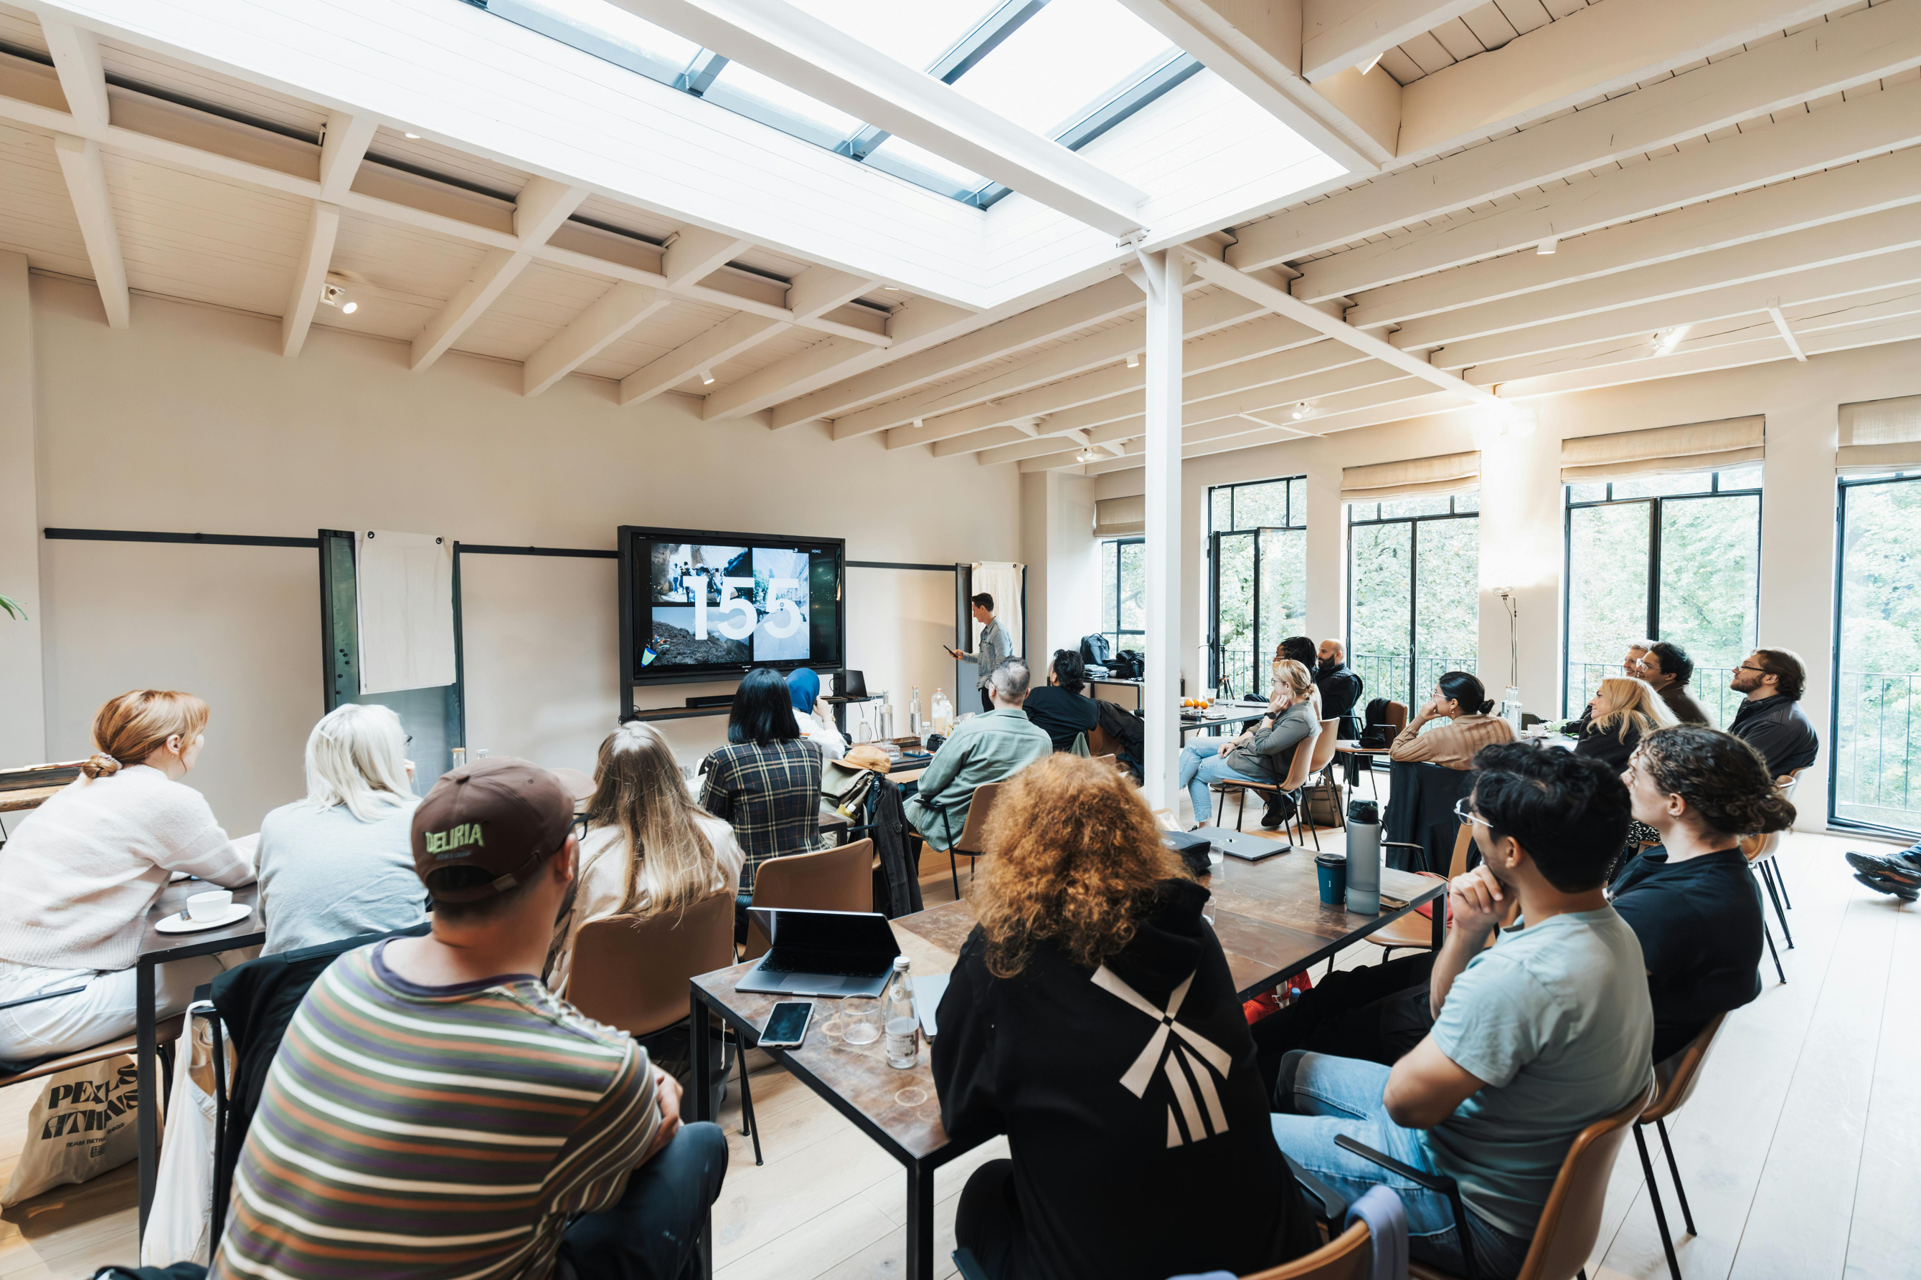
PROMOTING
DIGITAL FLUENCY
WORKSHOPS & TRAINING
Prompt engineering basics and critical evaluation of AI-generated information.
INFORMATION LITERACY
Teaching students to identify AI hallucinations and use AI responsibly.
FACULTY PARTNERSHIPS
Co-developing AI resource guides using various AI tools.

Slide 9

ETHICAL &
LEGAL CONSIDERATIONS
MISINFORMATION & BIAS
AI can produce inaccurate or biased information. Verify all outputs.
PRIVACY & SECURITY
Handle sensitive data responsibly. Be cautious with tools that store inputs.
INSTITUTIONAL POLICIES
Develop clear AI use guidelines for staff, faculty, and students.
COPYRIGHT
AI-generated content without human input isn't copyright protected.

Slide 10

U.S. COPYRIGHT OFFICE
POLICY ON AI
AI-ONLY CONTENT
HUMAN AUTHORSHIP
CITATION REQUIREMENT
Works generated solely by AI are not eligible for copyright protection
Human creators must significantly contribute for copyright eligibility
Cite AI-generated content even when copyright doesn't apply
Refer to official guidance: https://www.copyright.gov/ai/

Slide 11
AI TOOL
COMPARISON
Tool
Strengths
Limitations
Best For
Claude
Nuanced, context-rich responses
Lacks native citations
Detailed explanations
ChatGPT
Powerful research support
Requires output verification
Content creation
Perplexity
Source-backed research
Limited customization
Academic research
Consensus
Peer-reviewed sources
Narrower scope
Scientific queries
Gamma
Fast, professional visuals
Limited research functions
Presentations

Slide 12






DEMO TIME:
AI TOOLS IN ACTION
Perplexity
AI-powered research with real-time citations for factual Q&A
Elicit AI
Literature review synthesis and structured evidence extraction
Consensus AI
Scientific consensus answers from peer-reviewed literature
ChatGPT
Versatile research assistant with Custom GPTs for library tasks
Gamma
Creating presentations, documents, and visual content quickly
Feel free to sign in and join me as we proceed!

Slide 13

THE FUTURE OF
LIBRARIES & AI
AI AS PARTNER
AI augments librarian expertise. It handles routine tasks while staff focus on complex services.
SKILL EVOLUTION
Librarians become AI literacy educators. They help patrons navigate the AI landscape.
ENHANCED SYSTEMS
AI powers metadata tagging and knowledge organization. It improves discovery and accessibility.

Slide 14
CONCLUSION &
CALL TO ACTION
BE PROACTIVE
START SMALL
Lead ethical AI adoption in your library. Don't wait for others to set the standard.
Pilot AI projects in reference or outreach. Learn from small implementations.
COLLABORATE
EMPOWER PATRONS
Partner with IT, faculty, and administration. Develop comprehensive AI strategies.
Promote digital fluency through education. Teach responsible AI use.

Slide 15





THANK YOU
If you have any further questions or would like to discuss anything in more detail, please feel free to reach out to me.
donte.perry@rccc.edu
www.linkedin.com/in/donteperry/
donteperry.com

